Slide 1


JOY OF PYNQ
Unleash the joy of expressions!
Bhallaji Venkatesan
Sahana Sadagopan
Mounika Reddy
Divya Sampath Kumar

Slide 2
How it all started?
Right on Sept 13th, Apple bet on AR and Animated Emoji with custom A11 Bionic chip
and …. We met Pynq!!

Slide 3
Rapid Prototyping
Open Source Community with growing support
Concept of Interesting overlays providing great flexibility in functional implementation
Base overlay provided a conducive environment to allow interface of Grove Sensors alongside video transmission over HDMI
An easy-to-start with SoC for people with limited experience in the FPGA world and interested in leveraging the potential of FPGA
Why Pynq?

Slide 4
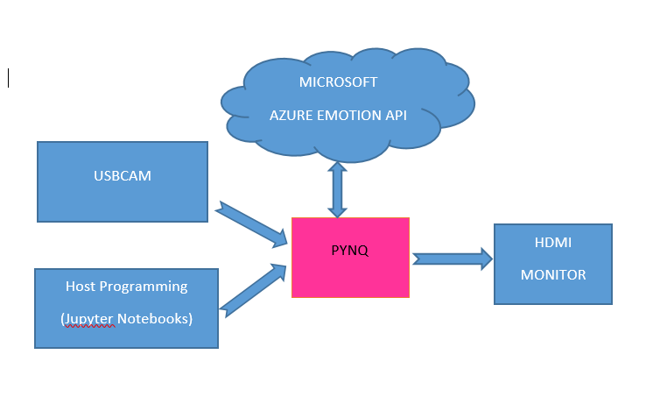
Pynq and its Utilization
Leveraged the video support provided in Base Overlay for Face Detect Operation using HDMI
Used a Logitech USB Webcam to capture video of a person
Utilized the Neural Network based Microsoft Azure Emotion API to detect facial expression of a person
Transmitted facial expression information seamlessly over HTTP Protocol
Used Jupyter notebook for development, allowing segmented code executions, making it easier for debugging sections of code effectively

Slide 5
Future Scope
To implement a custom training model that learns human facial expressions over time, enabling more accurate, varied and apt Emoji selection with power of customizable and reconfigurable hardware
Extend the model to include two Pynq Boards connected together and multiple overlays- one running the training model, and the other running the Video Processing Algorithms

Slide 6
To implement a custom training model that learns human facial expressions over time, enabling more accurate, varied and apt Emoji selection with power of customizable and reconfigurable hardware
Extend the model to include two Pynq Boards connected together and multiple overlays- one running the training model, and the other running the Video Processing Algorithms
Future Scope

Slide 7
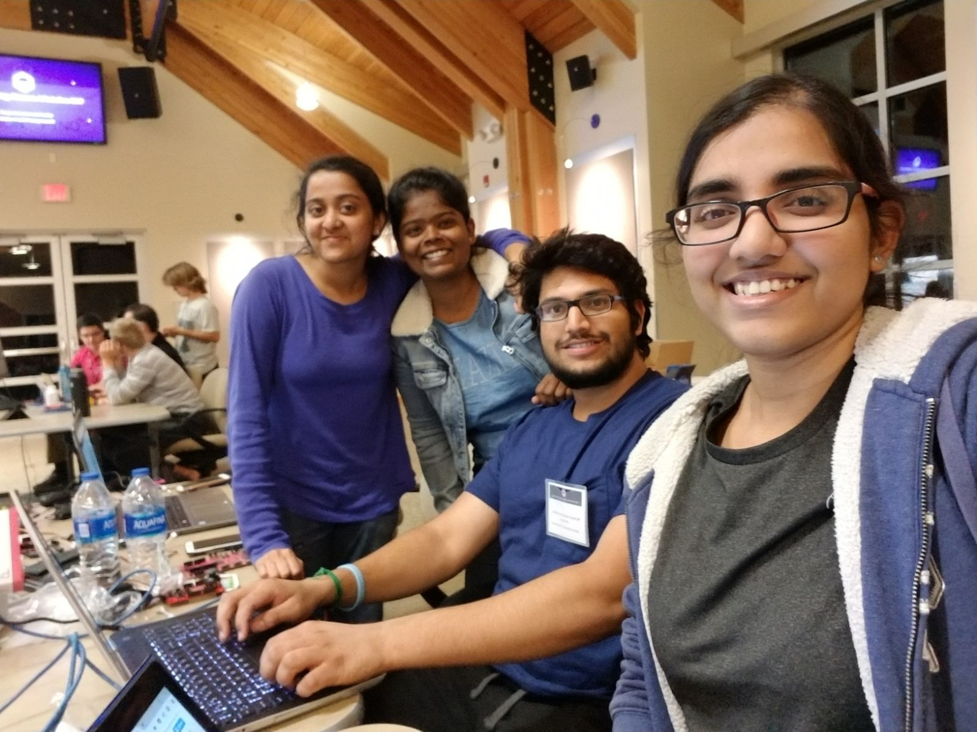
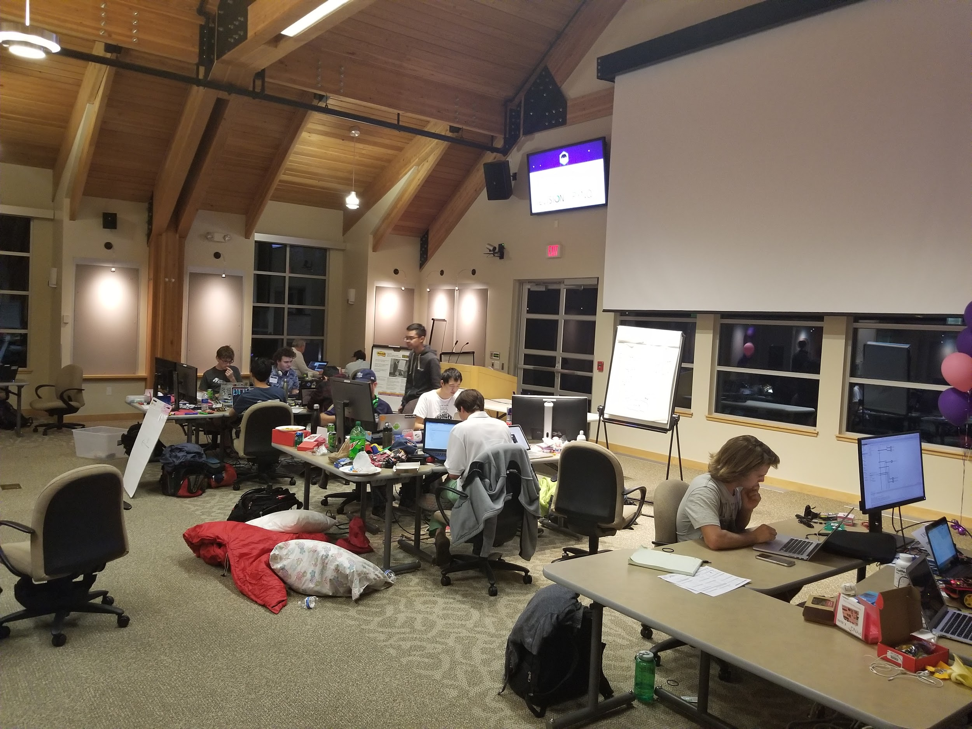
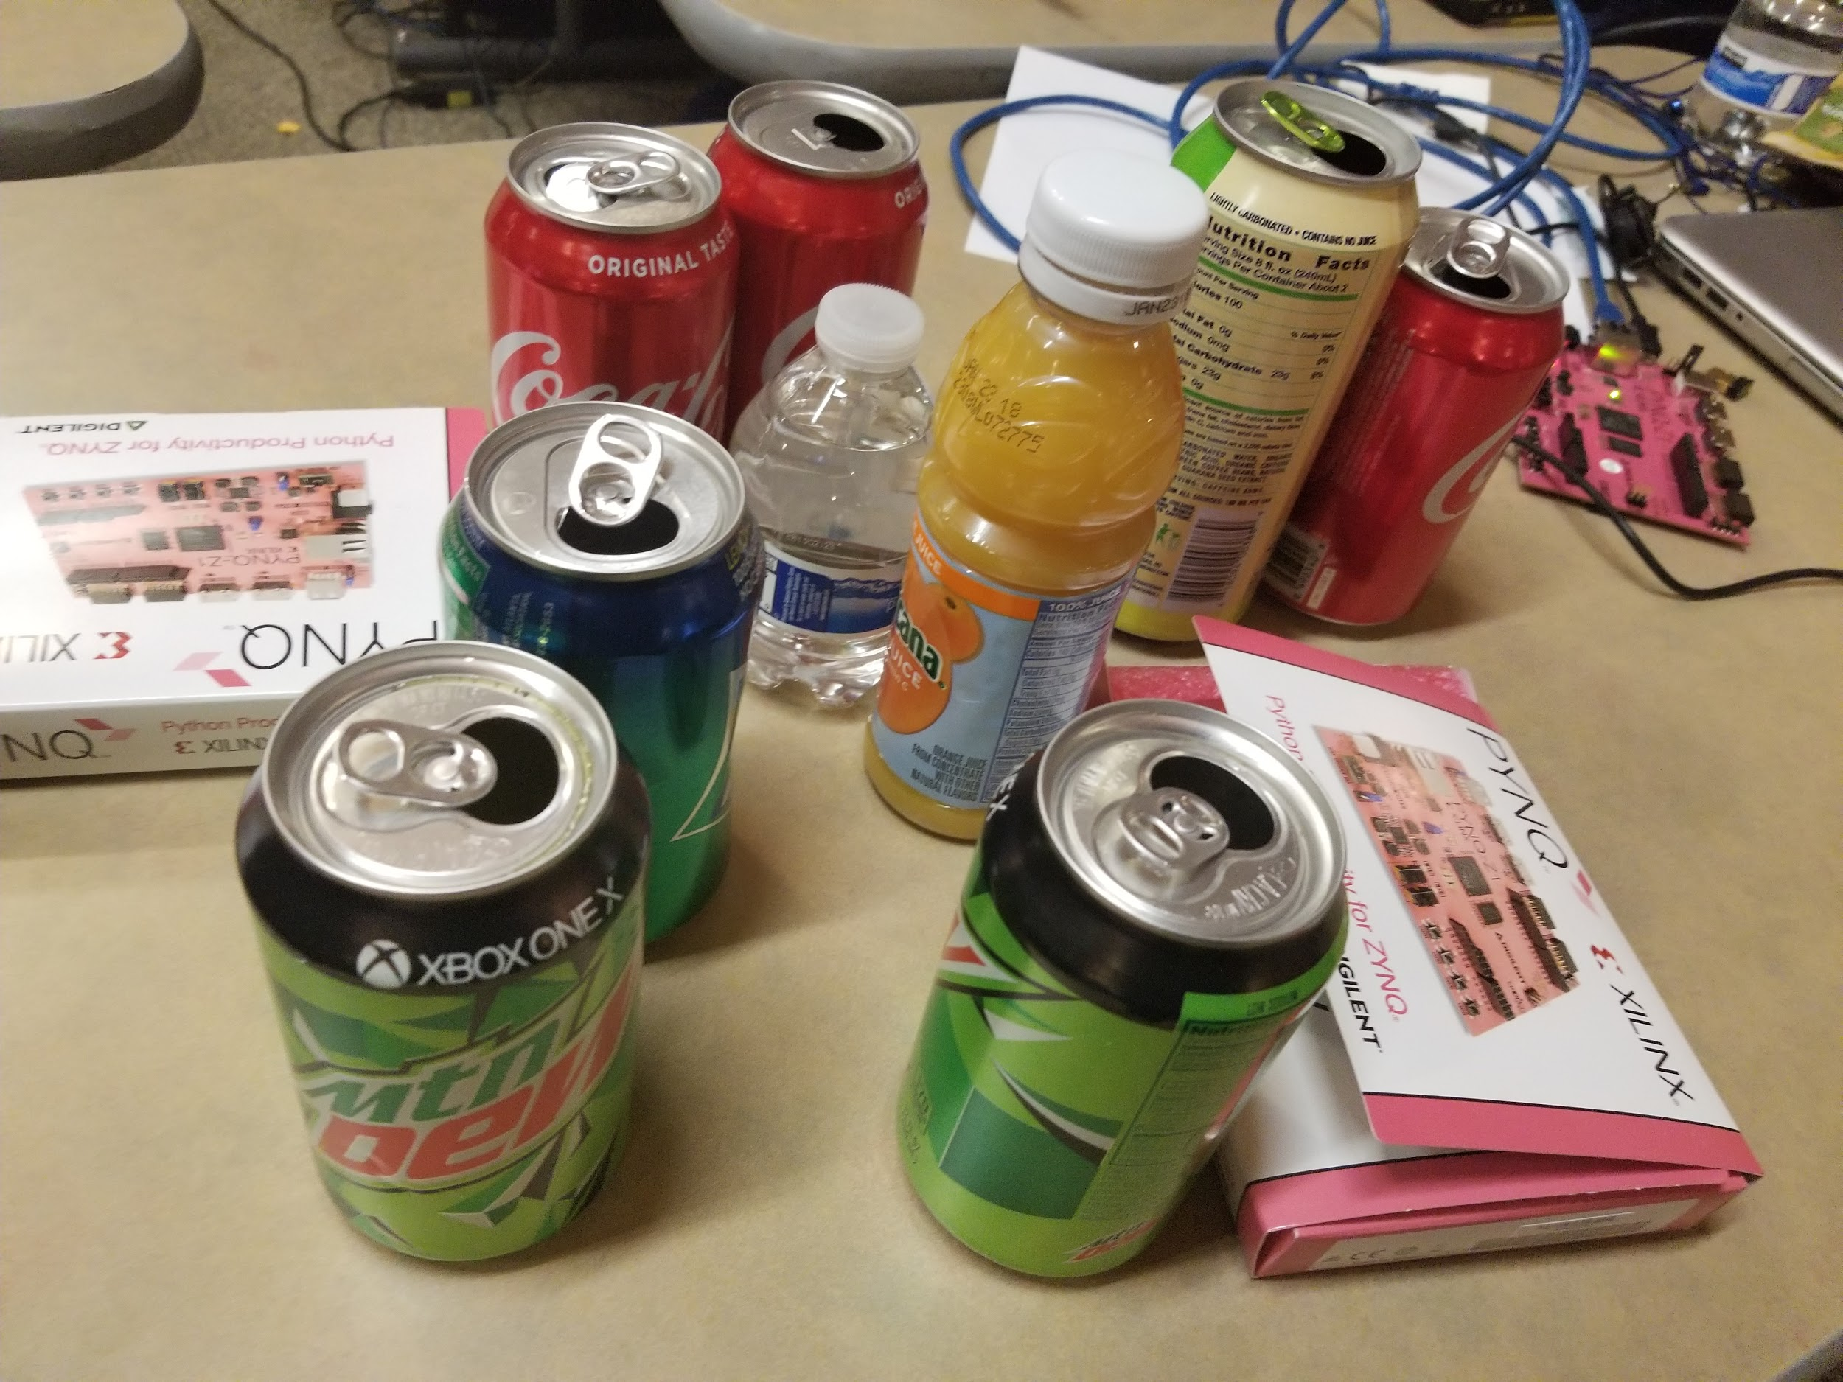
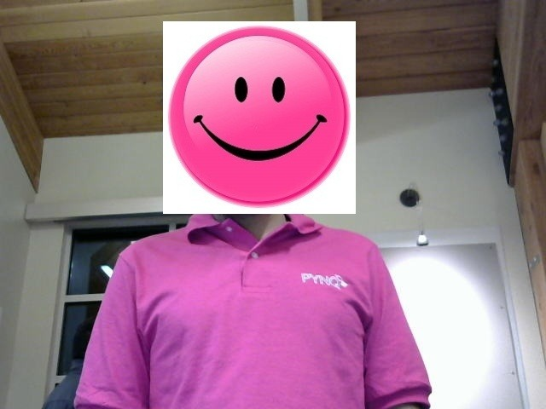
Cherished Moments…

Slide 8
A Special Thanks to...
Andrew Femrite
Graham Schelle
Vikhyat Goyal
Kiran Vishal
Naveen Purushottam
Dustin
And the rest of the team that organized this amazing and insightful event
Glad to be part of such an early stage open source project!

